Slide 1
An Improved Public Unclonable Function Design for Xilinx FPGAs for Hardware Security Applications 1st M.A.Sc Seminar
Presenter: Siva Prashanth B
Supervisor: Dr. Mohammed A. S. Khalid
Dr. Mitra Mirhasanni
Date: , 2018
University of Windsor
Department of Electrical and Computer Engineering

Slide 2
Seminar Outline
Introduction
Related Works
Problem Statement
Research Goals and Strategy
Experimental Evaluation & Comparison of Anderson and Modified Anderson PUF
Hardware Trojans for Secure licensing applications
Current Research Status
Summary
References

Slide 3
INTRODUCTION:
Physical Unclonable Functions (PUFs) are digital circuits that produce unique signature bits based on process variations that occur in manufacturing process in an Integrated Circuit(IC)
PUF’s eliminate the need to utilize expensive cryptographic algorithms for security. Instead we can use small part of the hardware as a security device
No need to store the secret keys in digital memory such as SRAM and EEPROM which could be vulnerable to many attacks

Slide 4
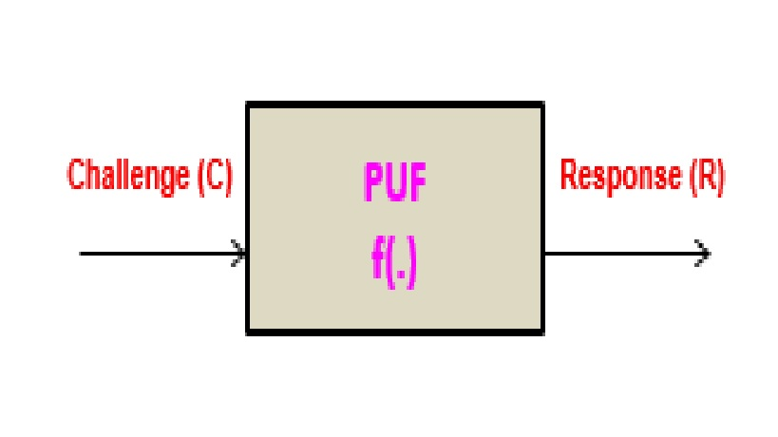
How does PUF work ??
A PUF is passed an input challenge C, and returns a response R
R = f (C), where f (.) describes the input/output relations of the PUF

Slide 5
Why PUFs are important ?
PUF hardware uses simple digital circuits that are easy to
fabricate or can use built in structures in Ics
Consumes less power and area than EEPROM/RAM based security solutions
Nonvolatile memory is more expensive to manufacture. EEPROMs require additional mask layers, and RAMs require an external always-on power source

Slide 6
Classification of PUF:
Weak PUF: Used For key storage. A weak PUF (also called as Physically Obfuscated PUF) has a very small range such that it can have collisions with one or other challenges that give the same response.
Strong PUF: Commonly used for authentication. Strong PUFs have a large domain and support a lot of Challenge Response Pairs (CRPs) that means they can be used effectively and securely.

Slide 7
Properties of PUF
Intra-Distance PUF Variation:
Its defined as the number of bits in a PUF response that change when the same challenge input is given to the PUF implemented at different locations on the same IC. Usually, this happens due to environmental variation and statistical noise
Inter-Distance PUF Variation:
Its defined as the number of bits in a PUF response that vary between different devices for the same challenges. This is due to differences in IC Fabrication. It’s the measure of the uniqueness

Slide 8
RELATED WORKS:
Anderson’s PUF:
a PUF circuit was designed using 2 LUTs, 2 carry chains and one F/F of the underlying architecture of 65nmVirtex 5 Xilinx FPGA.[5]
The PUF circuit consumes very little area (i.e) 2 slices so we can have less hardware overhead.

Slide 9
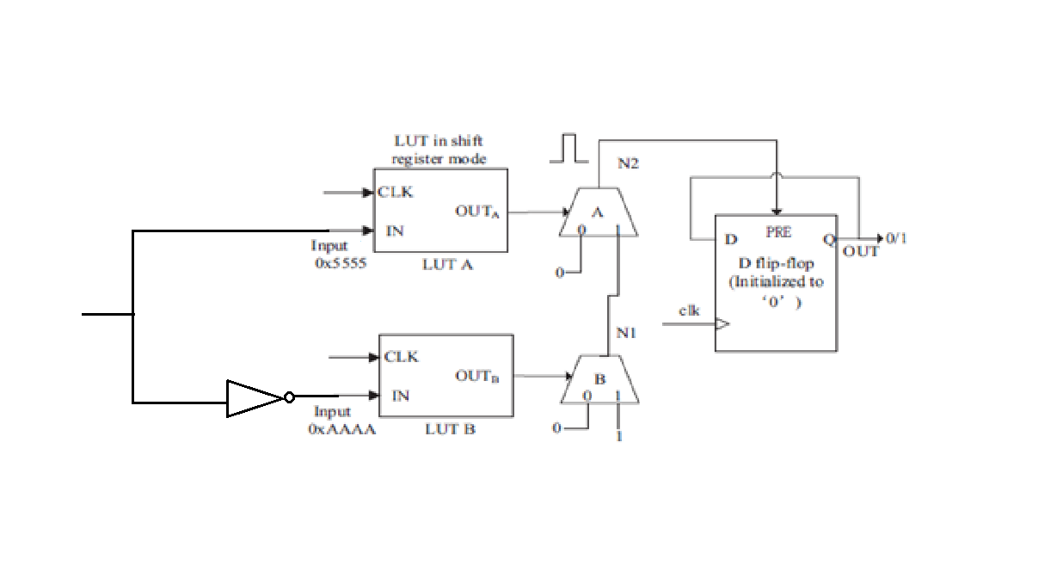
One Bit Anderson PUF
Shift_in

Slide 10
How the PUF works ?
clk LUTs A,B in shift register mode
A
IN
OUT
clk
…1010
0101…
OUT
B clk
…0101
IN
1010…

Slide 11
How the PUF works ?
clk
LUTs A,B in shift register mode
N2
OUT
clk
MUXA
0 1
A
…1010
0101… ^{IN}
logic-0
Carry chain multiplexers
N1
OUT
clk
MUXB
B
1010… ^{IN}
…0101
0
1
logic-0 logic-1

Slide 12
How the PUF works ?
clk
LUTs A,B in shift register mode
N2
OUT
clk
MUXA
0 1
A
…1010
Initially: N2: logic-0 N1: logic-1
0101… ^{IN}
logic-0
N1
OUT
clk
MUXB
B
1010… ^{IN}
…0101
0
1
logic-0 logic-1

Slide 13
How the PUF works ?
clk
LUTs A,B in shift register mode
N2
MUXA
0 1
At clock edge: MUX selects toggle
OUT
clk
A
…1010
0101… ^{IN}
logic-0
N1
Faster?
OUT
clk
MUXB
B
1010… ^{IN}
…0101
0
1
logic-0 logic-1

Slide 14
How the PUF works ?
clk Glitch!
N2
Faster?
MUXA changes before N1 →
pulse on N2.
OUT
clk
MUXA
0 1
A
…1010
0101… ^{IN}
logic-0
N1
OUT
clk
MUXB
B
1010… ^{IN}
…0101
0
1
logic-0 logic-1

Slide 15
How the PUF works ?
clk
N2
D PRE Q
PUF bit
OUT
clk
MUXA
0 1
A
…1010
0101… ^{IN}
Flip-flip initialized to logic-0
logic-0
N1
OUT
clk
MUXB
B
1010… ^{IN}
…0101
0
1
logic-0 logic-1

Slide 16
PROBLEM STATEMENT:
Creating an improved PUF model of an Anderson’s design for
Xilinx Virtex FPGA [2].
Measuring the Anderson’s PUF intra-distance variation of 90 bits.
we see an error of around 30% [2].

Slide 17
RESEARCH GOALS AND STRATEGY
Re-Designing the Anderson PUF to reduce intra PUF variation error
Designing an FSM based Hardware Trojan with the proposed PUF

Slide 18
Re-Design of Anderson PUF
Previous published research analysis [2] pointed out the design shortcomings that glitches of short duration are not enough to trigger the flip flop
To overcome this Constant glitch problem, we have:
1) A One-shot approach

Slide 19
One-shot approach:
This approach deals with increasing the glitch width.
We can increase the glitch width between LUTA and LUTB by adding an additional carry chain.
This glitch is given to the clear input of the flip flop.
This would be sufficient for the flip flop to generate the response for the PUF.

Slide 20
Modification of the Anderson’s PUF Design by changing the glitch from active high to active low
clk
D Q
CLR
N2
PUF bit
OUT
clk
MUXA
0 1
A
…1010
Flip-flip initialized to logic-1
0101… ^{IN}
logic-1
N1
OUT
clk
MUXB
B
1010… ^{IN}
…0101
0
1
logic-1 logic-0

Slide 21
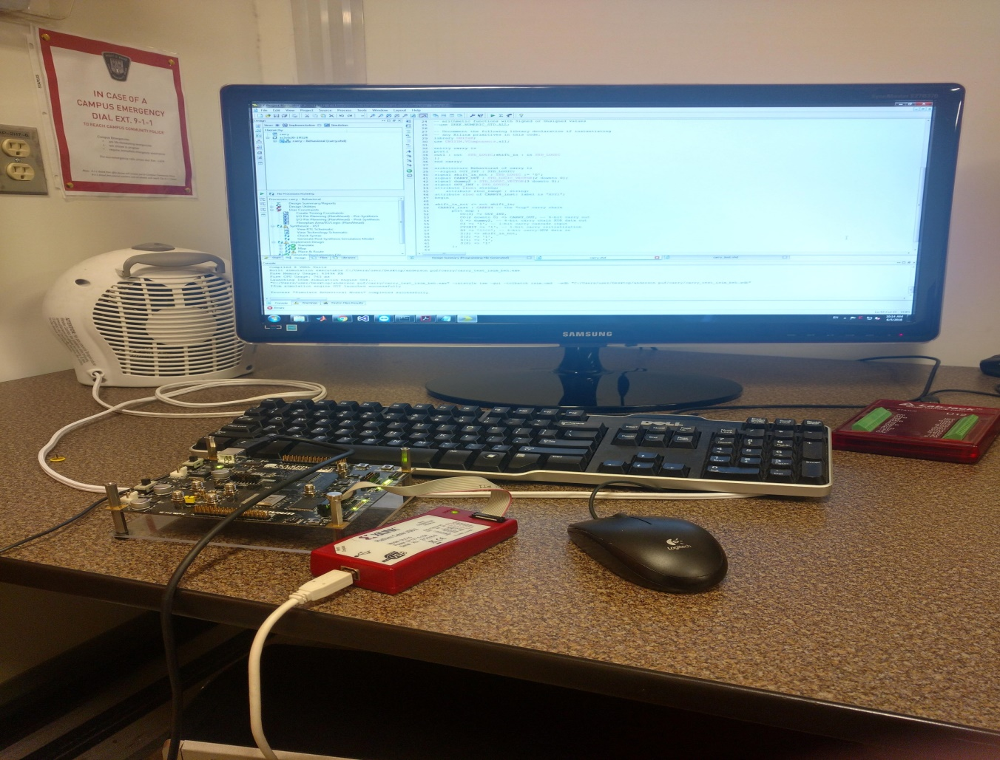
Experimental Evaluation & Comparison of Anderson and Modified Anderson PUF

Slide 22
Experimental Evaluation
We tested the Anderson PUF and modified Anderson PUF for Xilinx FPGA in 4 regions and studied the variation of the responses in each region.
Both PUFs were implemented as 90-bit PUFs
The challenge and response width was 90 bits

Slide 23
Virtex -5 FPGA divided in to 4 regions
Region 1
attribute rloc_range of SRL16E_inst: label is
"X0y0:X28Y40";
Region 2
attribute rloc_range of SRL16E_inst: label is "X0y41:X28Y79";
Region 3
attribute rloc_range of SRL16E_inst: label is "X32Y0:X52Y40";
Region 4
attribute rloc_range of SRL16E_inst: label is "X32Y41:X52Y79";
Region -1
Region -2
Region -3
Region -4
xc5vlx30

Slide 24
Anderson PUF Results for Region 2
PUF
x11FFFFFFFFFFFFFFFFFFFFF
x1808b030695609040076321

Slide 25
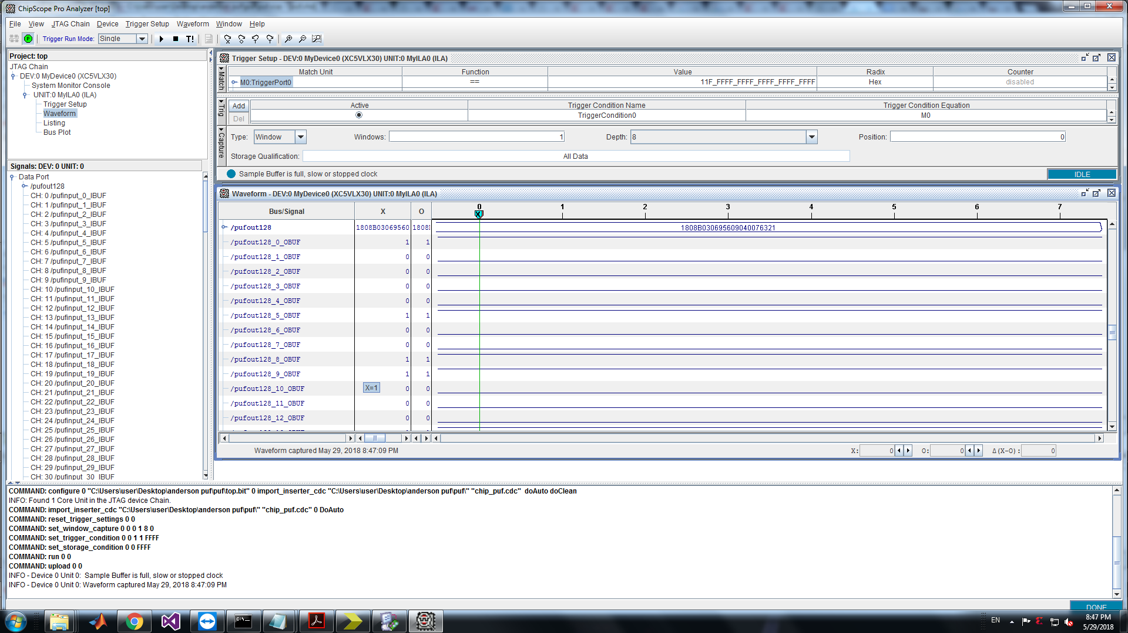
Fig 1 : Response of Anderson PUF for 90 Bits

Slide 26
Modified Anderson PUF Results for Region 2
PUF
x11FFFFFFFFFFFFFFFFFFFFF
x3a164c549900d2d30821410

Slide 27
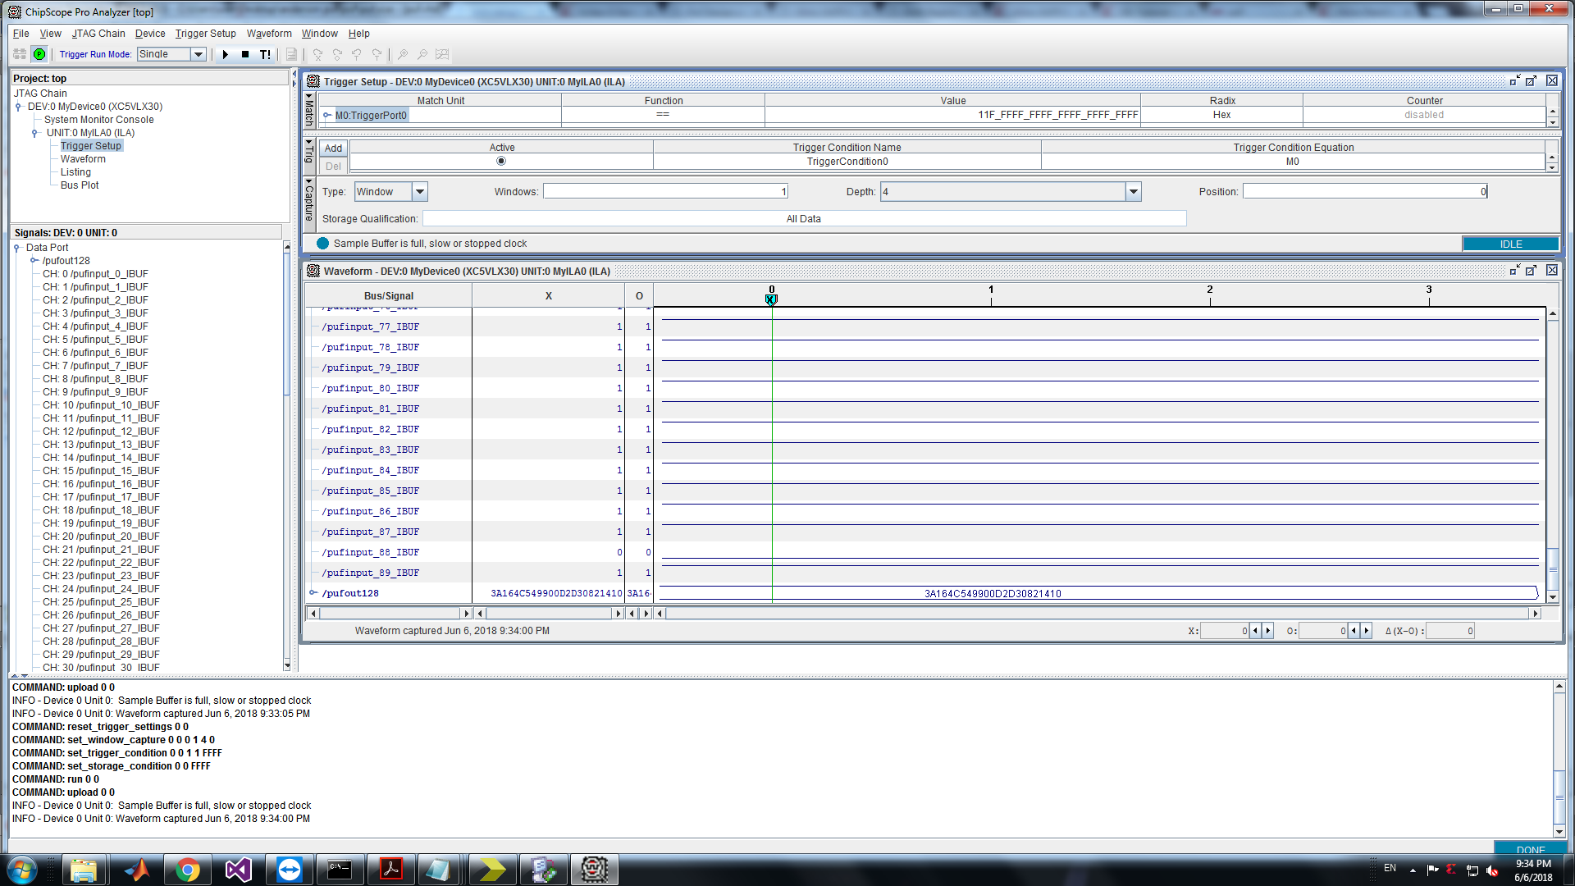
Fig 2 : Response of Modified Anderson PUF for 90 Bits

Slide 28
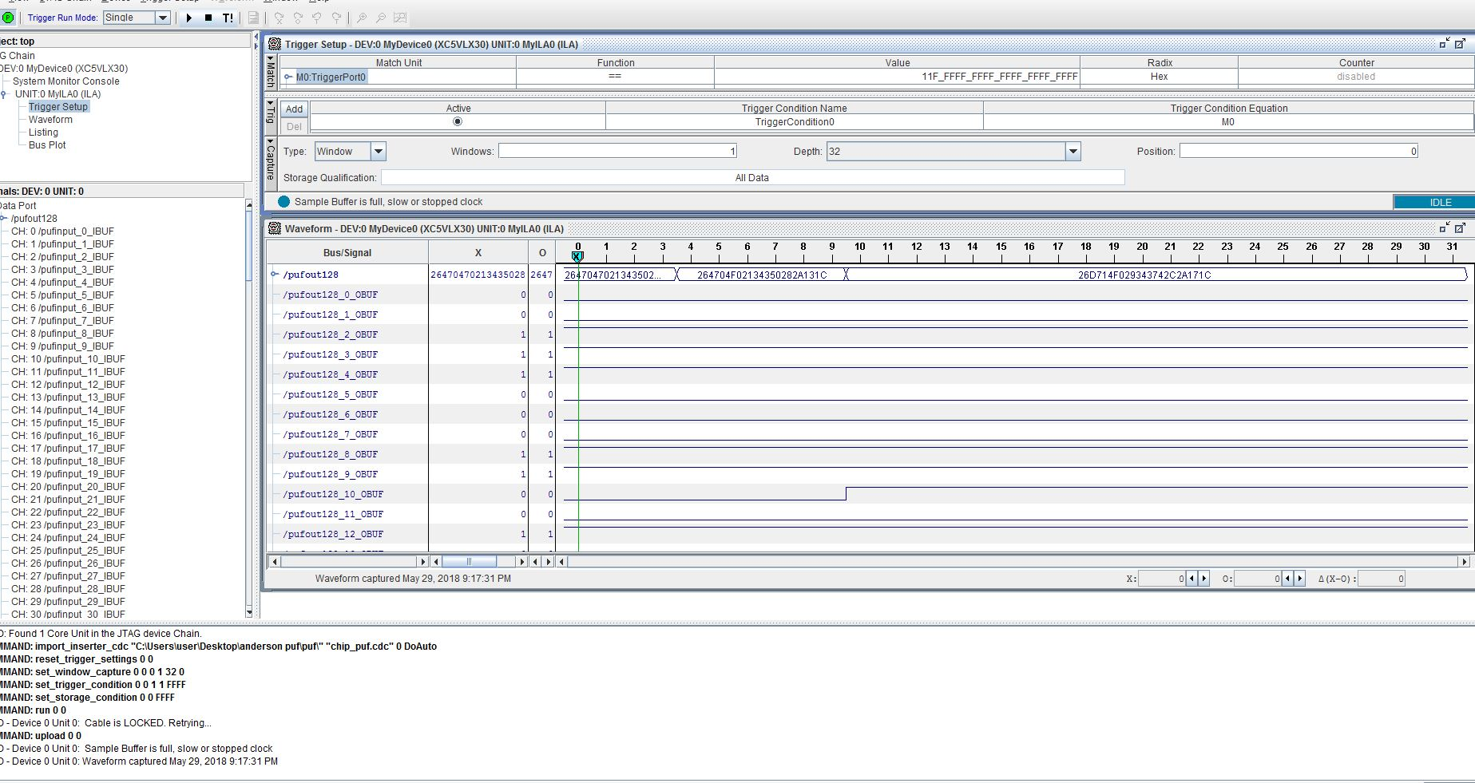
Fig 3 : Error on Anderson PUF for 90 bits

Slide 29
Fig 3 tells us that the value of response takes some time to settle as from[2].
This is because the glitch width is not enough to trigger the flip flop.

Slide 30
Fig 4 : Error reduced on Modified Anderson PUF for 90 bits

Slide 31
Plotting the graph For Hamming Distance vs density for both the PUFs
TERMINOLOGIES
Hamming Distance:
The Hamming Distance between a pair of 90 bit signatures is the number of bit positions in which the two signatures differ from one another.
Density:
It’s defined as the fraction of PUF pairs that have hamming distance values in a specific range

Slide 32
Plotting the graph with responses vs density for both the PUF
Fig 5 : Intra-distance metrics for a 90-bit Anderson PUF

Slide 33
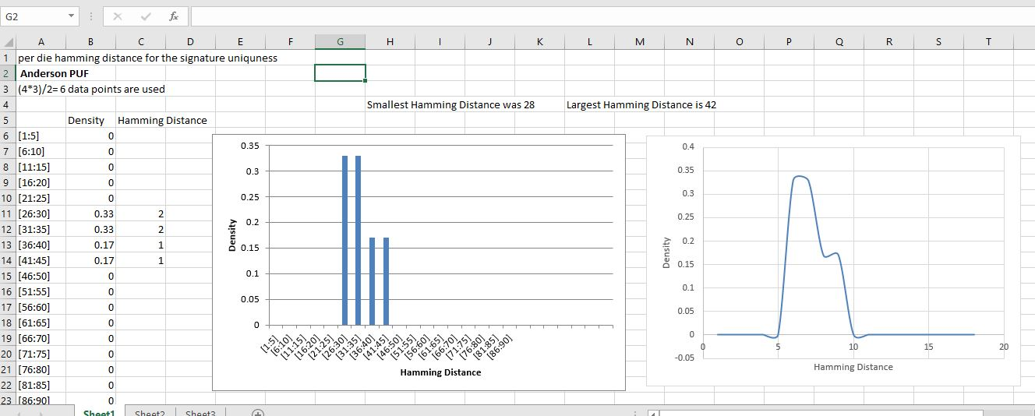
Fig 6 : Evaluation of Anderson PUF

Slide 34
Experimental Results
Fig 7 : Intra-distance metrics for a 90-bit Modified Anderson PUF

Slide 35
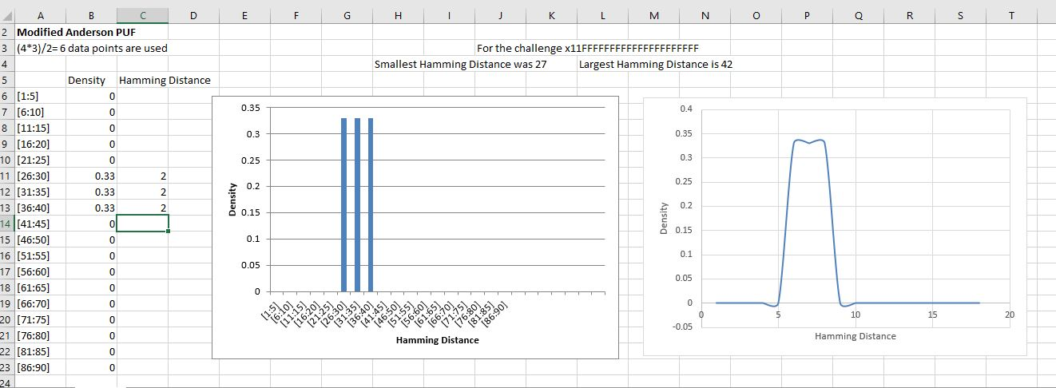
Fig 8 : Evaluation of Modified Anderson PUF

Slide 36
SUMMARY
Thus the modified PUF can give the responses without any transitions
We also proved that it generated different signatures for different regions inside the FPGA
We can say that the error has been reduced and it can be reliably used for security authentications

Slide 37
Hardware Trojans for Secure licensing applications
IP Providers sell VHDL and Verilog IP cores to many unknown customers
Many industries try to trace the IP and make their own pirated designs
We can use Hardware Trojan (HT) to stop IP piracy
HT is a malicious modification of the digital circuitry of an integrated circuit. HT is completely characterized by its physical representation and its behaviour
We use FSM based securing algorithm for protecting the IP cores [6]
This FSM needs to be hidden from attackers. Obfuscation technique will be used during this research based on re-simulating the FSM of the IP core with the added FSM to gather a flattened netlist.

Slide 38
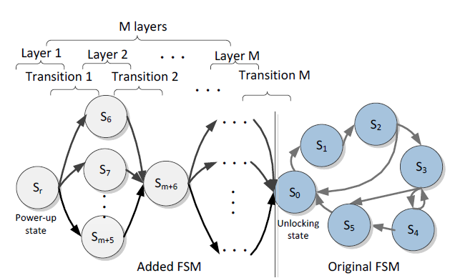
The binding FSM structure. The original states are shown in dark and the added states are shown in white on the STG of the added FSM. [3]
FSM Model of a Trojan

Slide 39
ASM For FSM Based Trojan for 4 Bit Divider IP consisting of 3 States
Clk_Count0
S4
Clk_Count0=250000
Clk_Count0=
Clk_Count0+1
False
True
They are counters that run on Clock
to check for the evaluation time
Clk_Count1
S5
Clk_Count1=250000
Clk_Count1=
Clk_Count1+1
False
True
S6

Slide 40
ASM For FSM Based Trojan for 4 Bit Divider IP consisting of 3 States
Clk_Count2
S6
Clk_Count2=250000
Clk_Count2=
Clk_Count2+1
False
True
Eval=1
S8
Eval=1
Normal Division Algorithm
will be performed
False
True
By Setting these values to zero
we disrupt the functionality
S0
Q← 0
R ← 0

Slide 41
ASM For FSM Based Trojan for 4 Bit Divider IP consisting of 3 States
Fm=0001
Reset
RR← 0
C← 3
S0
RA← Dividend
RB ← Divisor
Start
0
1
S1

Slide 42
ASM For FSM Based Trojan for 4 Bit Divider IP consisting of 3 States
S1
RR||RA ← Shl RR || RA
S2
C ← C - 1
False
RR >= RB
True
RQ ← Shl RQ|| 0
RQ ← Shl RQ|| 1
RR ← RR - RB

Slide 43
ASM For FSM Based Trojan for 4 Bit Divider IP consisting of 3 States
C = 0
False
S1
Done
Q ⬅ RQ
R ⬅ RR
S3
S0

Slide 44
Expected Implementation and Results:
The proposed PUF and the binding FSM IP protection method will be implemented on Xilinx FPGA Tools.
ISE is used for Virtex-5 and lower devices and Vivado is used for recent devices higher than Virtex-7.
To evaluate the effectiveness of the proposed binding method using the Md(Obfuscated Metric)[6].
The area, timing and power overhead will be studied.

Slide 45
CURRENT RESEARCH STATUS
Obtained results for the proposed PUF with a change in glitch value .
Designed FSM based model for a simple divider IP.
Results for Re-Design of the Proposed PUF has been shown.

Slide 46
SUMMARY:
Thus PUFs can act as a good low cost Hardware Protection for FPGA Devices
They can be used for Anti - Counterfeiting, Anti-Cloning, Trusted Storage, Secure Payments, Machine to Machine and Device to Cloud Authentication
It can be designed to make it as an evaluation version and later can be made in such a way that the users will pay for it when they are using the IP

Slide 47
FUTURE RECOMMENDATIONS:
Investigation of whether the saturation effect itself is an intrinsic property of an FPGA device
Analysing protection and detection techniques on ASIC’s instead of FPGAs
Comparing the security strength of the proposed designs

Slide 48
REFERENCES:
[1] J.H Anderson. A PUF design for secure FPGA-based embedded systems. In ASP-DAC, pages 1-6, 2010.
[2] P. Grabher, D. Page and M. Wojcik. On the (re) design of an FPGA-based PUF, International Association for Cryptologic Research, 2013.
[3] A. Al-Anwar, Y. Alkabani, M. W. El-Kharashi and H. Bedour, "Hardware Trojan detection methodology for FPGA," 2013 IEEE Pacific Rim Conference on Communications, Computers and Signal Processing (PACRIM), Victoria, BC, 2013, pp. 177-182.
[4] M. Rostami, F. Koushanfar and R. Karri, "A Primer on Hardware Security: Models, Methods, and Metrics," in Proceedings of the IEEE, vol. 102, no. 8, pp. 1283-1295, Aug. 2014.
[5] Virtex-5 FPGA Data Sheet, Xilinx, Inc., San Jose, CA, 2007.
[6] M. Majzoobi, F. Koushanfar, and M. Potkonjak, “Techniques for design and implementation of secure reconfigurable PUFs,”ACM Trans. on Reconfigurable Technology and Systems, vol. 2,no. 1, pp. 1–33, 2009.

Slide 49
REFERENCES:
[7] Jeroen Leijten, Jef van Meerbergen and Jochen Jess,“Analysis and Reduction of Glitches in Synchronous Networks”, Department of Electrical Engineering, Eindhoven University of Technology, The Netherlands.
[8] R. Brodersen, A. Chandrakasan and S. Sheng, “Low-Power Signal Processing Systems”, 5th IEEE Workshop on VLSI Signal Processing, California, USA, October 1992.
[9] C. Herder, M. D. Yu, F. Koushanfar and S. Devadas, "Physical Unclonable Functions and Applications: A Tutorial," in Proceedings of the IEEE, vol. 102, no. 8, pp. 1126-1141, Aug. 2014.

Slide 50

QUESTIONS

Slide 51
THANK YOU

